Slide 1
软件体系结构
7 层次体系结构风格
刘旭东
cameran@hit.edu.cn
Saturday, November 7, 2026

Slide 2
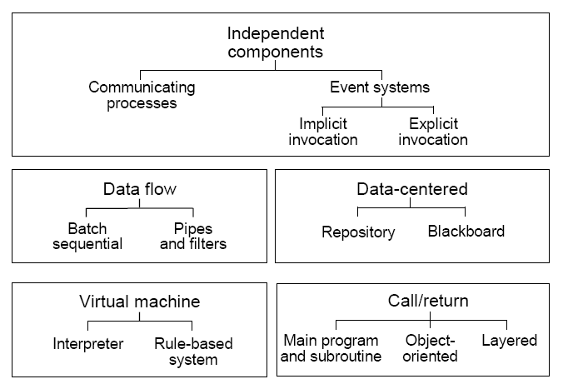
主要内容

Slide 3
主要内容
7.1层次系统
7.2分层模式
7.3分层系统中的交互模式
7.4层次系统的几个典型例子
7.5分层系统的优缺点分析
7.6API设计原则

Slide 4
7.1 分层系统
Layered Systems

Slide 5
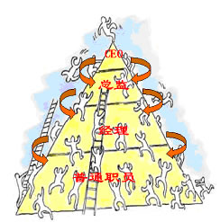
层次结构
层次化早已经成为一种复杂系统设计的普遍性原则；
分层模式在现实生活中很常见：
  社会；
  公司；

Slide 6
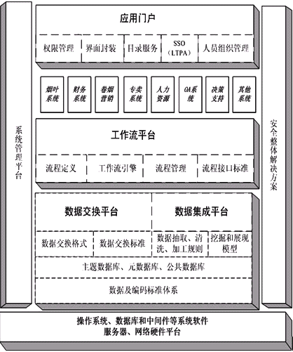
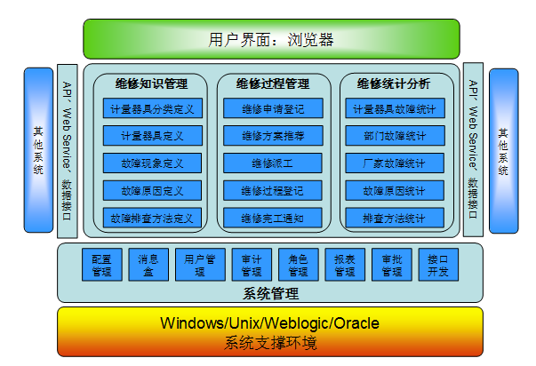
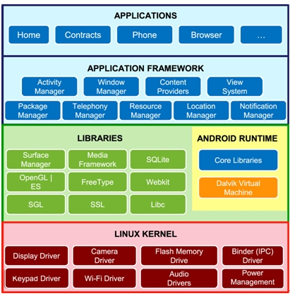
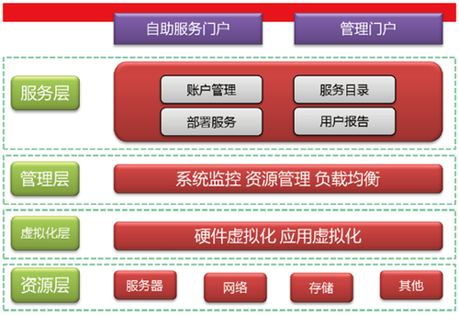
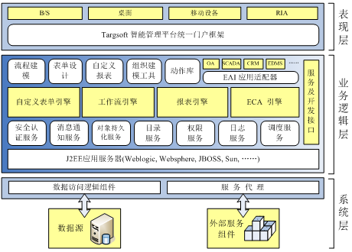
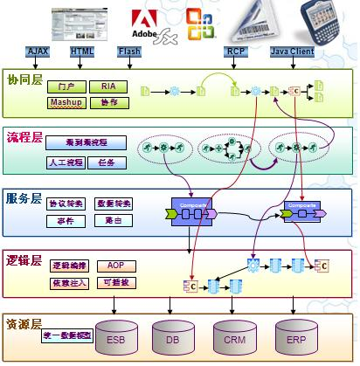
分层模型被“滥用”?

Slide 7
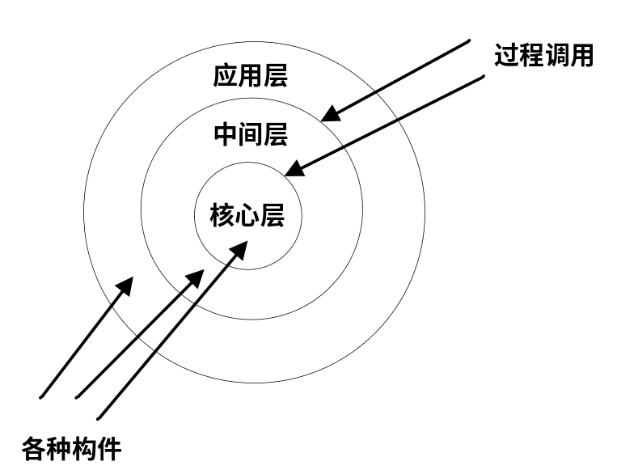
Layered System
A layered system is a system in which
  components are grouped, i.e., layered, in a hierarchical arrangement (在层次系统中，系统被组织成若干个层次，每个层次由一系列构件组成)
  lower layers provide functions and services that support the functions and services of higher layers (下层构件向上层构件提供服务)
  higher layers serves as a client to the layer below (上层构件被看作是下层构件的客户)

Slide 8
Layered System
Layering Principles(分层原则)
  Separation of concerns(分离关注), Break your application into distinct features that overlap in functionality as little as possible.
  Abstraction(抽象),Concentrating on the essential, force out the irrelevant.
  Hiding(隐藏),Restriction to the visibility of details to those parts of a system that need them.
不同的层次处于不同的抽象级别：
  越靠近底层(硬件与OS)，抽象级别越高，越通用；
  越靠近顶层(用户)，抽象级别越低，越具体；
Notes:
A layer is formed often by around 10-100 modules, which can encapsulate several object types themselves.

Slide 9
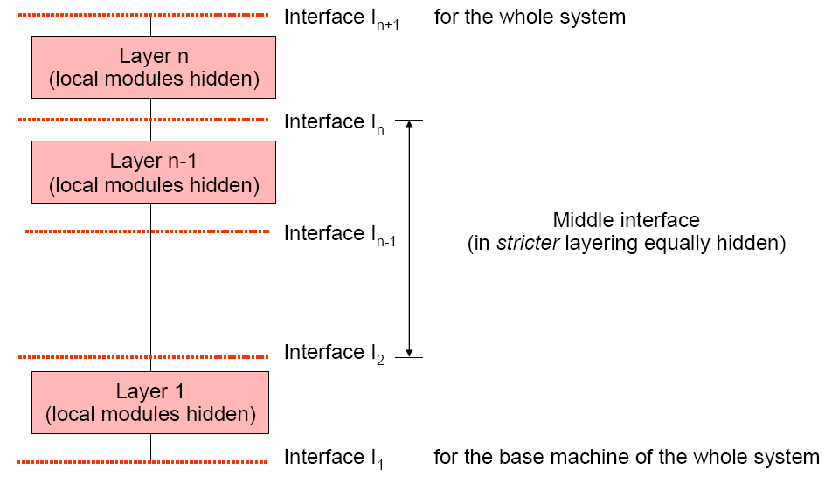
Layered System
层次之间存在接口，通过接口
形成call/return的关系，上层是
下层的客户

Slide 10
Layered System
The components are defined in each layer. (层次系统的基本构件：各层次内部包含的构件)
The connectors are defined by the protocols that determine how the layers will interact.(连接件：层间的交互协议)
Topology: layered structure. (拓扑结构：分层)
Topological constraints include limiting interactions to adjacent layers.(拓扑约束：对相邻层间交互的约束)
  Mainframe(集中式部署)
  Distributed(分布式部署)

Slide 11
7.2 分层模式
Layering Patterns

Slide 12
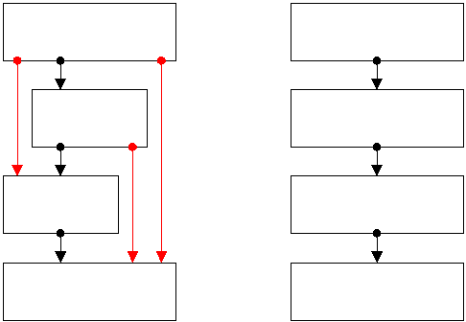
分层模式
某一层中的构件一般只与同一级别中的对等实体或较低级别中的构件交互，这种单向交互有助于减少不同级别中的构件之间的依赖性。(思考：下层构件如何与上层构件交互？)
分层模式：
  严格分层(Strict System Layering)
  松散分层(Loosely System Layering)
  横切关注(Cross-Cutting Concerns)
Notes:
隐式调用
反向控制（依赖注入）

Slide 13
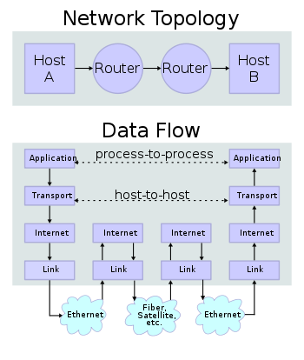
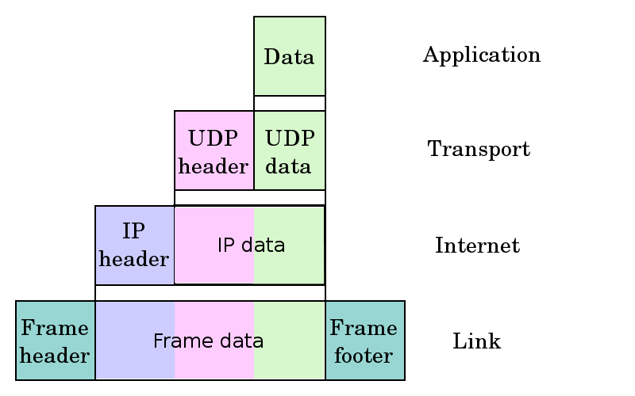
严格分层 (Strict System Layering)
A strictly layered system enforces the layering concept as a system design and construction criterion. (严格分层系统要求严格遵循分层原则)
Such a system design allows an entity at layer N only to interact with entities at layers N+1 and N-1 and no other layers. (第 N 层只能与第 N-1 和N+1层中的构件进行交互，第 N-1 层只能与第 N和N-2 层进行交互，依次类推)

Slide 14
严格分层 (Strict System Layering)
The advantage to a strictly layered system is the simplicity with which it can be modified. (严格分层的优点：修改时的简单性)
  If one adds a new layer N entity or replaces it, the sphere of interaction with other parts of the entire system is quite limited and easy to manage. (当某一层被加入或被替换时，它的影响范围很有限，容易管理)
The disadvantage of a strictly layered system is that it can be inefficient to deal with intermediate layers when there is an interaction between entities at distant layers. (缺点：效率低)

Slide 15
严格分层 (Strict System Layering)
Networking systems are built using the layering concept extensively and are often criticized for their inefficiency. (网络系统中使用严格分层，但导致效率低下)
  In some cases, the inefficiencies are indeed caused by excessively strict layering.
Most actual systems, however, do not follow strict layering and the layering is more conceptual than actual. (因此在很多实际系统里，并不遵循严格分层的原则)

Slide 16
松散分层 (Loosely System Layering)
松散的分层应用程序放宽了此限制，它允许构件与位于它下面的任意层中的组件进行交互
  第N 层不仅可以与第 N-1 层交互，而且可以与第 N-2 层和第 N-3 层交互。
优点：松散方法可以改善效率。
缺点：松散方法在层之间不提供相同的隔离级别，这使得对较低层的修改影响范围扩大，修改困难。

Slide 17
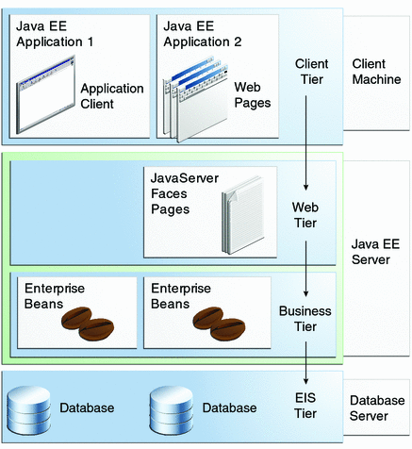
混合分层(J2EE中的严格分层与松散分层)
Notes:
http://docs.oracle.com/javaee/6/tutorial/doc/bnaay.html

Slide 18
Cross-cutting concerns(横切关注)
cross-cutting concerns are aspects of a program which affect other concerns. These concerns often cannot be cleanly decomposed from the rest of the system in both the design and implementation, and can result in either scattering (code duplication), tangling (significant dependencies between systems), or both. E.g. security, logging, etc.(例如安全、日志等模块)
Notes:
http://en.wikipedia.org/wiki/Cross-cutting_concern
http://msdn.microsoft.com/en-us/library/ee658124.aspx

Slide 19
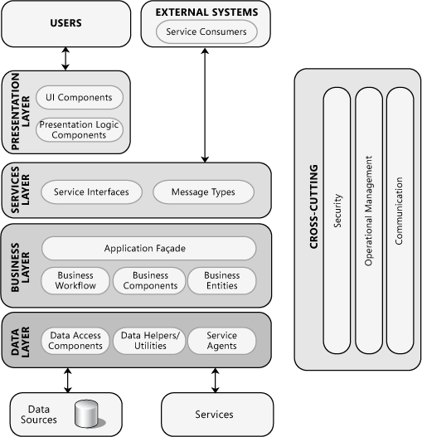
Cross-cutting concerns(横切关注)
Microsoft Application Architecture

Slide 20
7.3 分层系统中的交互模式

Slide 21
分层系统中两种交互模式
前面学习的分层模式(严格分层、松散分层)是从各层之间可能存在的交互关系来分类；
那么，针对分层系统中层间交互的“激发性”（谁发起调用Call），分为以下两种基本的交互模式：
  由上而下的交互模式 (top-down triggering)
  由下而上的交互模式 (bottom-up triggering)
Notes:
李千目教材

Slide 22
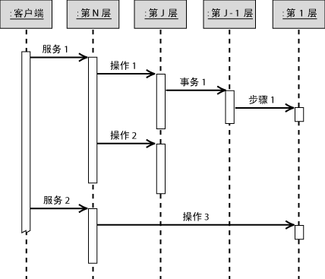
由上而下模式
在由上而下模式中，外部实体与系统中的最高层交互。
最高层使用较低级别层的一个或多个服务。
反过来，每个较低级别都使用它下面的层，直到到达最低层。
外界与系统的交互点

Slide 23
由上而下模式
一个传入调用可能导致多个传出调用。
  第 N 层上的服务 1 的调用说明了这种情况。
  当较高级别服务聚合几个较低级别服务的结果，或协调多个必须按特定的顺序执行的较低级服务的执行时，通常会发生这种情况。
  例如，客户端提交订单，同时系统记录操作日志。
外界与系统的交互点

Slide 24
由上而下模式
顶层服务的调用并不一定会到达(调用)所有层。
  例如：服务 1 到操作 2 顺序。
  当较高级别可以处理自身中的调用，或者缓存了较早的某个请求的结果时，就会发生这种情况。
  例如，域组件通常缓存数据库查询的结果，这使得将来调用时不必调用数据访问层。
  例如，WEB应用程序中，用户发送用户注册请求，服务器端进行校验，如果校验不合格，不调用数据访问层将该用户加入系统。
外界与系统的交互点

Slide 25
由上而下模式
可能会使用松散的分层方法。
  服务 2 的实现绕过了所有中间层而直接调用第 1 层。
  例如，数据维护应用程序绕过任何中间业务逻辑层而直接访问数据访问层的表示层。
外界与系统的交互点

Slide 26
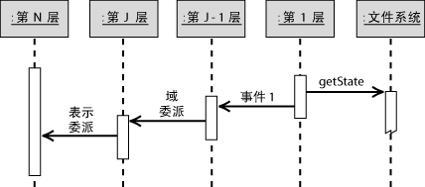
由下而上模式
在由下而上模式中，外部实体与系统中的最底层交互，通常用来监视某些底层系统的状态变化。
当被监控对象状态发生改变时，触发系统最底层的某些服务；
每个较低级别回调它上面的层的服务，直到到达最顶层；
在此方案中，客户端只能使用最底层的一组服务，而无法直接了解任何较高的层。
例如：病毒监控程序,QQ消息提醒等.
外界与系统的交互点

Slide 27
二者的区别
在由上而下方案中，较高层直接调用较低层，因此高层依赖于低层。
在由下而上方案中，较低层通过事件(event)、回调(callback)或委派(delegate)来与较高层通信。
由上而下的信息和控制通常被描述成请求(request)；
由下而上的方式被描述为通知(notify)。
Notes:
In .NET, a delegate is a way of telling which method to call when an event is triggered, keeping the method type.

Slide 28
Bi-directional Layering (双向分层)
However, in a communication system, information must travel in both directions. (在某些网络/通讯系统里，信息必须在两个方向都可以传递)
  A high level entity on the sending system interacts with a lower level entity on the sending system setting off a chain of interactions. (发送端系统中：高层→低层)
  This chain eventually results in an interaction between a very low level entity in the sending system and a very low level entity in the receiving system. (发送端与接收端系统在最底层的交互)
  A new chain of interactions works its way up the layers in the sending system until a message is delivered to some high level entity in the receiving system. (接收端系统中：低层→高层)

Slide 29
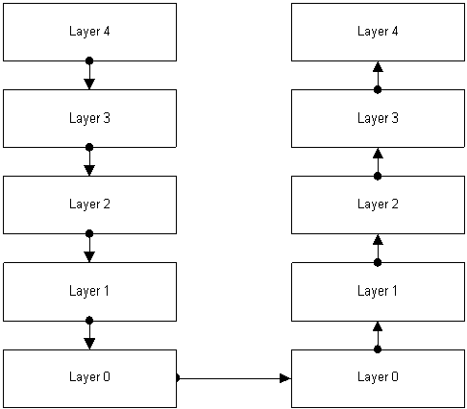
Bi-directional Layering (双向分层)

Slide 30
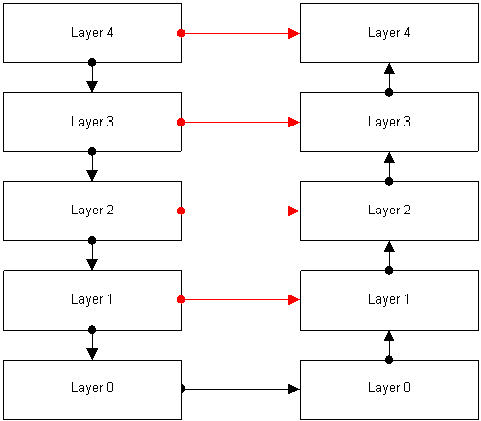
双向分层中端对端的虚拟通讯
在分层的网络通讯系统里，同一层次之间的交互：
  在物理上通过双向分层的方式完成；
  在逻辑上可看作端对端的虚拟通讯。

Slide 31
7.4 分层系统的几个例子
Some Examples

Slide 32
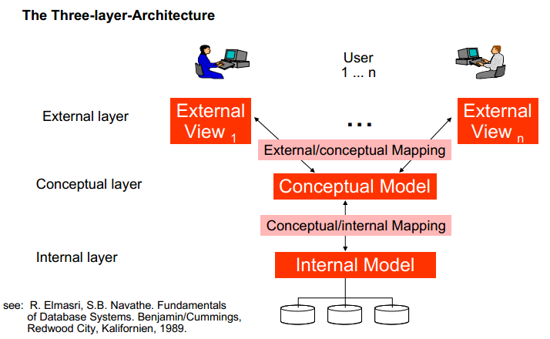
DBMS中的“三级模式-两层映像”
Advantages:
Logical Data independence
Physical Data independence
Notes:
external model
-Each external model describes the view of one or several users on the data.
-Data not relevant for the user are hidden from him.
conceptual model
-The conceptual model establishes the structures of the conceptual view of the whole database for the whole user community (unification of all user views in one common view).
-Entity, data type, relation and integrity conditions are taken into account.
Internal model
-The internal model describes the physical memory structures of the database.
-Details of data storage and access paths are described under use of a physical data model.

Slide 33
计算机操作系统(OS)的层次结构
用户
Shell解释运行/GUI
语言处理、系统工具、系统应用程序
系统API
操作系统内核(System kernel)
基本输入输出(BIOS)
计算机硬件(CPU、存储器、I/O等)

Slide 34
信息系统的典型分层结构
客户端层
应用程序客户端：GUI
用户接口、操作界面
表示层
JSP/Servlet等
登陆、会话管理、
内容创建、显示格式和传输
业务逻辑层
JavaBean/EJB等
业务逻辑、事务、
数据、服务
集成层
通过JDBC/RMI/JMS等与数据库
或其他资源的连接
连接器、规则引擎、
工作流、资源适配器
资源层
数据库、消息队列、遗留系统等
资源、数据库、
消息、外部系统
——引自<<J2EE核心模式>>

Slide 35
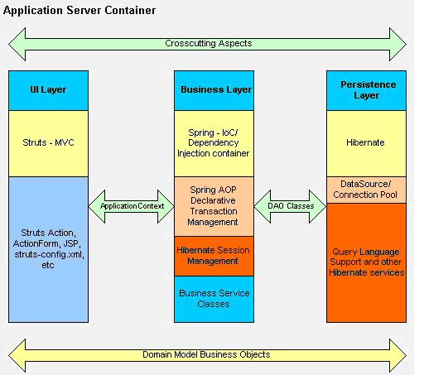
SSH分层架构(Struts-Spring-Hibernate)

Slide 36
7.5 分层系统的优缺点分析

Slide 37
Advantages of Layered System
支持基于抽象程度递增的系统设计，有利于设计者对一个复杂系统进行分解；
局部依赖性，因为每一层至多和相邻的上下层交互，因此功能的改变通常影响相邻的上下层；
可复用性，如果某独立层保证了功能的完整性并且提供了文档化的接口，便可在 多个语境中复用。
可替换性，只要提供的服务接口定义不变，同一层的不同实现可以交换使用。这样，就可以定义一组标准的接口，而允许各种不同的实现方法。
对标准化的支持。清晰定义并且广泛接受的抽象层次能够促进实现标准化的任务和接口开发，同样接口的不同实现能够互换使用。
可测试性。具有定义明确的层接口以及交换层接口的各个实现的能力提高了可测试性。

Slide 38
Disadvantages of Layered System
并不是每个系统都可以很容易地划分为分层的模式，甚至即使一个系统的逻辑结构是层次化的，出于对系统性能的考虑，系统设计师不得不把一些低级或高级的功能综合起来；
效率的降低：
  由分层风格构成的系统，运行效率往往低于整体结构。
  在上层中的服务如果有很多依赖于最底层，则相关的数据必须通过一些中间层的若干次转化，才能传到；
很难找到合适的、正确的层次抽象方法：
  层数太少，分层不能完全发挥这种风格的可复用性、可更改性和可移植性上的潜力。
  层数过多，则引入不必要的复杂性和层间隔离冗余以及层间传输开销。
  目前，没有可行的广为人们所认可的层粒度的确定和层任务的分配方法。

Slide 39
7.6 API设计原则

Slide 40
应用程序编程接口API
An application programming interface (API) is a source code-based specification intended to be used as an interface by software components to communicate with each other. An API may include specifications for routines, data structures, object classes, and variables.
  language-dependent (语言相关API) meaning it is only available by using the syntax and elements of a particular language.
  language-independent (语言无关API), written so that it can be called from several programming languages.
API design goals
  absolutely correct
  easy to use
  easy to learn
  compatibility
  fast enough
  small enough

Slide 41
API libraries and frameworks
An API is usually related to a software library (API类库)
  the API describes and prescribes the expected behavior while the library is an actual implementation of this set of rules. A single API can have multiple implementations (or none, being abstract) in the form of different libraries that share the same programming interface.
An API can also be related to a software framework (框架的API)
  a framework can be based on several libraries implementing several APIs, but unlike the normal use of an API, the access to the behavior built into the framework is mediated by extending its content with new classes plugged into the framework itself. Moreover the overall program flow of control can be out of the control of the caller, and in the hands of the framework via inversion of control or a similar mechanisms.

Slide 42
API设计原则
Design to evolve(为变化为设计)
  once something is in the API it will stay there, classes and methods are never removed
  it's a good idea to bring out one or more 0.x versions before the 1.0 version. Users of these versions know that the API is unstable and won't curse you if it changes
  create a new API with different package names
Be minimalist(极度简约)
  The more stuff there is in the API, the harder it is to learn.
  The bigger the API, the more things can go wrong
  Think of problems a user might want to solve with the API, Code the solutions. Remove anything from the API that your examples don't need
Be careful with packages(小心包的使用)
  put your whole API in one package. For an API with fewer than about 30 public classes this is usually the best approach.
  If your API is too big for a single package to be appropriate, then you should plan to have private implementation packages. A good convention for private packages is to put internal in the name.
Notes:
The Java language has fairly limited ways of controlling the visibility of classes and methods. In particular, if a class or method is visible outside its package, then it is visible to all code in all packages. This means that if you define your API in several packages, you have to be careful to avoid being forced to make things public just so that code in other packages in the API can access them.

Slide 43
API设计原则
Interfaces are overvalued(在必要的地方使用interface定义API)
  Callbacks, If the interface is intended to be implemented by user code, then it is often more appropriate than an abstract class. Notice that every methods must be implemented by the user code.
  Multiple inheritance
  Dynamic proxies
Immutable classes are good(使用不可改变类)
  If a class can be immutable, then it should be. (避免出错)
The only visible fields should be static and final(对外可见的属性应为静态的或不变的)
  Again this one is pretty banal and I mention it only because certain early APIs in the core platform violated it. Not an example to follow.
Avoid eccentricity(遵照惯例).
  There are many well-established conventions for Java code, with regard to identifier case, getters and setters, standard exception classes, and so on.
……
Notes:
Immutable classes的属性为static final，不可改变
http://www.artima.com/weblogs/viewpost.jsp?thread=142428

Slide 44
结束

